Slide 1
张量网络优化算法
答辩人 孙玉鑫 指导老师 何力新 教授

Slide 2
Contents
Research Experience
My Work About Tensor Network

Slide 3

1st year: no research
2nd year: single-layer material (${\text{MoTe}}_{2}$), NV center, tournament
3rd year: change from experimental to computational works, learn about tensor network
4th year: optimize SGD method, undergraduate thesis.

Slide 4



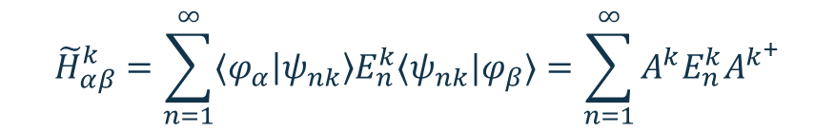

Summer Research
$\left|φ_{α}\right\rangle$: Lowdin Basis
$\left|ψ_{nk}\right\rangle$: Plane Wave Basis
LaNi$O_{3}$
Ask QE to calculate $\left\langle φ_{α}\left|H^{k}\right|φ_{β}\right\rangle ={\tilde{H}}_{αβ}^{k}$
$$H^{k}=\sum_{n=1}^{∞}{\left|ψ_{nk}\right\rangle E_{n}^{k}⟨ψ_{nk}|}$$
$${\tilde{H}}_{αβ}^{k}=\sum_{n=1}^{∞}{⟨φ_{α}\left|ψ_{nk}\right\rangle E_{n}^{k}⟨ψ_{nk}|φ_{β}⟩}=\sum_{n=1}^{∞}{A^{k}E_{n}^{k}A^{k^{+}}}$$
Block-diagonalize $\tilde{H}$ to disentangle p and d bands.
Find well-localized Wannier Functions

Slide 5
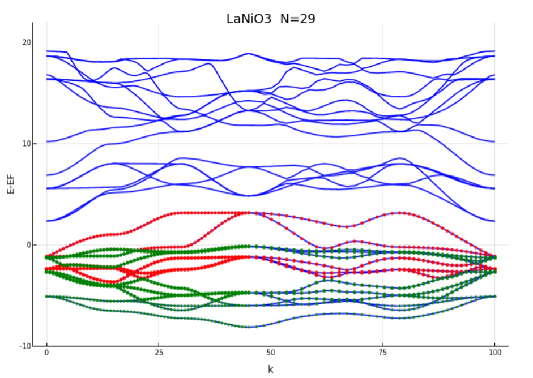
Summer Research

Slide 6
Tensor Network
for systems with no external magnet field, tensor network representation in field of real number is sufficient.

Slide 7
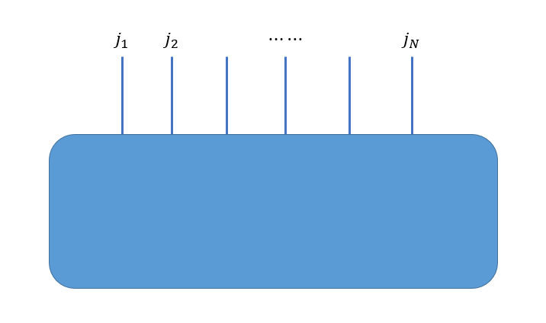
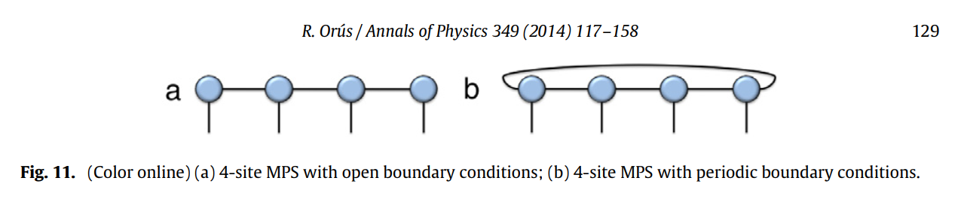
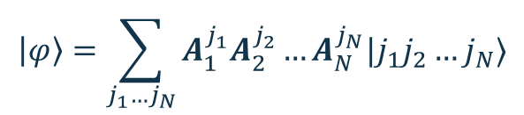


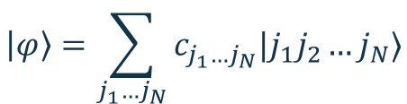
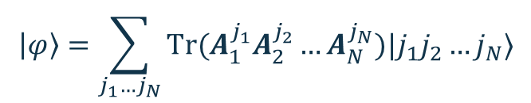
Tensor Network
Matrix Product State
consider $N$ particles, each has $J$ spin states:
$$\left|φ\right\rangle =\sum_{j_{1}…j_{N}}{c_{j_{1}…j_{N}}|j_{1}j_{2}…j_{N}⟩}$$
$$j_{n}=1,2,…,J$$
number of data need to use: $J^{N}$
$$\left|φ\right\rangle =\sum_{j_{1}…j_{N}}{A_{1}^{j_{1}}A_{2}^{j_{2}}…A_{N}^{j_{N}}|j_{1}j_{2}…j_{N}⟩}$$
OBC
$$\left|φ\right\rangle =\sum_{j_{1}…j_{N}}{Tr(A_{1}^{j_{1}}A_{2}^{j_{2}}…A_{N}^{j_{N}})|j_{1}j_{2}…j_{N}⟩}$$
PBC
number of data need to use : $NJD^{2}$, $N=4$ here.
$A_{i}^{j_{i}}$ are $D×D$ matrices. $A_{1}^{j_{1}}$ and $A_{N}^{j_{N}}$ are vectors in OBC.
Notes:
图片引用自
A Practical Introduction to Tensor Networks: Matrix Product States and Projected Entangled Pair States

Slide 8






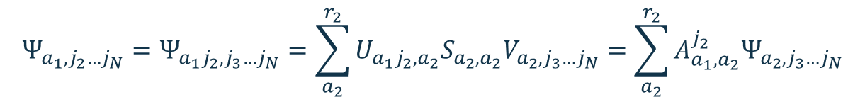

Tensor Network
$$\left|φ\right\rangle =\sum_{j_{1}…j_{N}}{c_{j_{1}…j_{N}}|j_{1}j_{2}…j_{N}⟩}$$
$$c_{j_{1}…j_{N}}=Ψ_{j_{1},j_{2}…j_{N}}=\sum_{a_{1}}^{r_{1}}{U_{j_{1},a_{1}}S_{a_{1},a_{1}}V_{a_{1},j_{2}…j_{N}}}=\sum_{a_{1}}^{r_{1}}{A_{a_{1}}^{j_{1}}Ψ_{a_{1},j_{2}…j_{N}}}$$
$$Ψ_{a_{1},j_{2}…j_{N}}=Ψ_{a_{1}j_{2},j_{3}…j_{N}}=\sum_{a_{2}}^{r_{2}}{U_{a_{1}j_{2},a_{2}}S_{a_{2},a_{2}}V_{a_{2},j_{3}…j_{N}}}=\sum_{a_{2}}^{r_{2}}{A_{a_{1},a_{2}}^{j_{2}}Ψ_{a_{2},j_{3}…j_{N}}}$$
$$c_{j_{1}…j_{N}}=\sum_{a_{1}}^{r_{1}}{\sum_{a_{2}}^{r_{2}}{A_{a_{1}}^{j_{1}}A_{a_{1},a_{2}}^{j_{2}}}}Ψ_{a_{2},j_{3}…j_{N}}$$
therefore
Singular Value Decomposition (SVD)
$$⋮$$
$$A=U∗S∗V$$
$$c_{j_{1}…j_{N}}=\sum_{a_{1},…,a_{N−1}}^{r_{1},…,r_{N−1}}{A_{a_{1}}^{j_{1}}A_{a_{1},a_{2}}^{j_{2}}⋯A_{a_{N−2},a_{N−1}}^{j_{N−1}}}A_{a_{N−1}}^{j_{N} }$$
$S=$diag$\left\{λ_{1},λ_{2},…\right\}, S≥0$

Slide 9
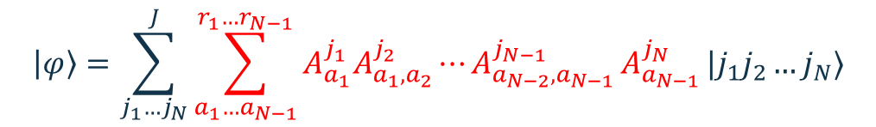


Tensor Network
$$\left|φ\right\rangle =\sum_{j_{1}…j_{N}}{c_{j_{1}…j_{N}}|j_{1}j_{2}…j_{N}⟩}$$
$$\left|φ\right\rangle =\sum_{j_{1}…j_{N}}^{J}{\sum_{a_{1}…a_{N−1}}^{r_{1}…r_{N−1}}{A_{a_{1}}^{j_{1}}A_{a_{1},a_{2}}^{j_{2}}⋯A_{a_{N−2},a_{N−1}}^{j_{N−1}}}A_{a_{N−1}}^{j_{N} }}|j_{1}j_{2}…j_{N}⟩$$
$r_{1}≤J, r_{2}≤r_{1}J≤J^{2}, r_{m}≤$min$\{J^{m},J^{N−m}\}$
we make cutoff $r_{m}≤D$ in practice: only keep $D$ largest singular values.
This is a good approximation because of the area law.

Slide 10
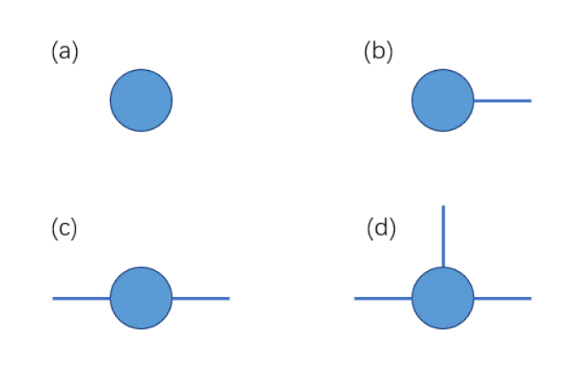
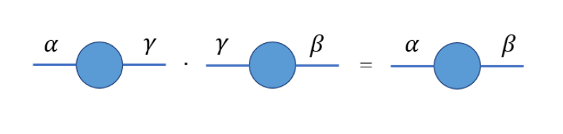


Tensor Network
tensor $→$ diagram:
scalar
vector
matrix
3-dim tensor
$$C=A∗B→C_{αβ}={\left(AB\right)}_{αβ}=\sum_{γ}{A_{αγ}B_{γβ}}$$

Slide 11
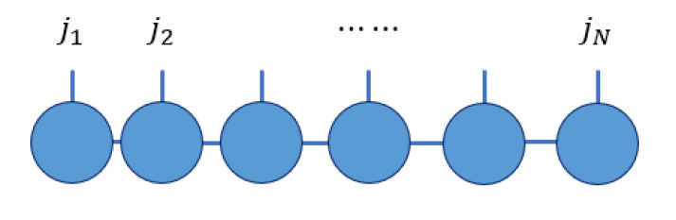


Tensor Network
tensor $→$ diagram:
$$\left|φ\right\rangle =\sum_{j_{1}…j_{N}}^{J}{\sum_{a_{1}…a_{N−1}}^{r_{1}…r_{N−1}}{A_{a_{1}}^{j_{1}}A_{a_{1},a_{2}}^{j_{2}}⋯A_{a_{N−2},a_{N−1}}^{j_{N−1}}}A_{a_{N−1}}^{j_{N} }}|j_{1}j_{2}…j_{N}⟩$$
$$A_{1}^{j_{1}}A_{2}^{j_{2}}…A_{N}^{j_{N}}=\sum_{a_{1}…a_{N−1}}^{r_{1}…r_{N−1}}{A_{a_{1}}^{j_{1}}A_{a_{1},a_{2}}^{j_{2}}⋯A_{a_{N−2},a_{N−1}}^{j_{N−1}}}A_{a_{N−1}}^{j_{N} }$$

Slide 12
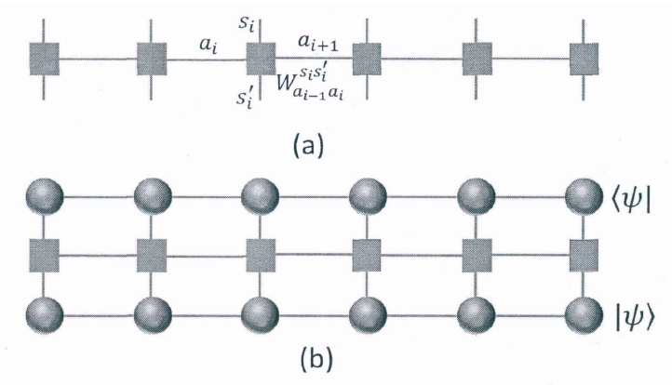








Tensor Network
tensor $→$ diagram:
$$\hat{H}=J\sum_{i}{{\vec{σ}}_{i}⋅{\vec{σ}}_{i+1}}$$
$$j_{i}$$
$$j_{i+1}$$
$${\vec{σ}}_{i}⋅{\vec{σ}}_{i+1}→$$
$$j_{i}′$$
$$j_{i+1}′$$
$$→\left\langle j_{i}j_{i+1}\left|{\vec{σ}}_{i}⋅{\vec{σ}}_{i+1}\right|j_{i}^{′}j_{i+1}^{′}\right\rangle$$
$$⟨ψ|H|ψ⟩$$

Slide 13
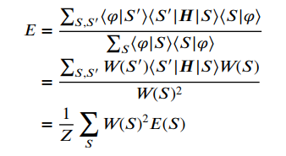

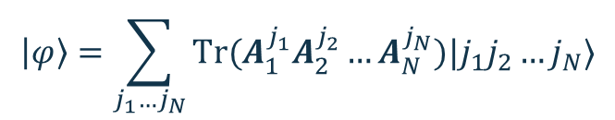

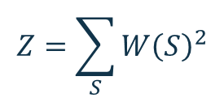


Tensor Network
Seek ground state using Stochastic Gradient Descent:
$$\left|φ\right\rangle =\sum_{j_{1}…j_{N}}{Tr(A_{1}^{j_{1}}A_{2}^{j_{2}}…A_{N}^{j_{N}})|j_{1}j_{2}…j_{N}⟩}$$
current state
energy
$$E=\frac{\left\langle φ | H | φ\right\rangle }{\left\langle φ | φ\right\rangle }$$
insert identity matrix
$$I=∑|S⟩⟨S|=∑|S′⟩⟨S′|$$
$$Z=\sum_{S}{W{\left(S\right)}^{2}}$$
where
$$W\left(S\right)=\left\langle S | φ\right\rangle =Tr(A_{1}^{s_{1}}A_{2}^{s_{2}}…A_{N}^{s_{N}})$$
$S$ refers to the variables $j_{1}=s_{1}, j_{2}=s_{2}, …, j_{N}=s_{N}.$
See P24 in thesis for details
Notes:
开边界

Slide 14
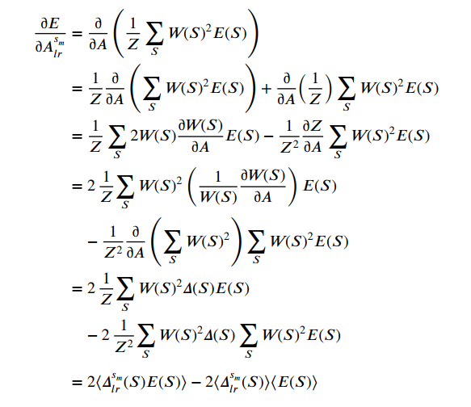




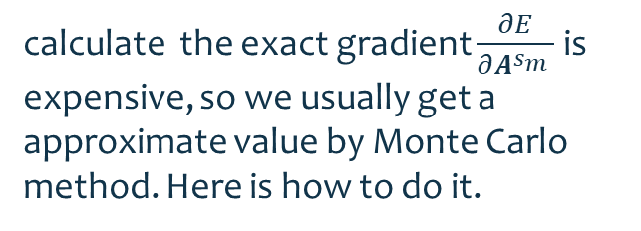
Tensor Network
calculate the exact gradient $\frac{∂E}{∂A^{s_{m}} }$ is expensive, so we usually get a approximate value by Monte Carlo method. Here is how to do it.
$A_{m}^{s_{m}}$ are $D×D$ matrices.
Here $A_{lr}^{s_{m}}$ means the matrix element ${\left(A_{m}^{s_{m}}\right)}_{l,r}$
$$W\left(S\right)=$$
with
$$\frac{∂W(S)}{∂A^{s_{m}} }=$$

Slide 15









Tensor Network
$$Z=\sum_{S}{W{\left(S\right)}^{2}}$$
$$S_{1}$$
$$S_{2}$$
$$S_{3}$$
$$S_{n}$$
generate a Markov chain of $S$ with weights $W{\left(S\right)}^{2}$, we can get a approximation of gradient $∂E/∂A^{s_{m}}$.
$\frac{∂E}{∂A^{s_{m}} }=2\left\langle Δ^{s_{m}}(S)E(S)\right\rangle −2\left\langle Δ^{s_{m}}(S)\right\rangle$ $\left\langle E(S)\right\rangle$
$$\left\langle ⋅ \right\rangle → \frac{1}{n}\sum{ ⋅}$$
we do gradient descent at $k$th step for all matrices:
$$A^{s_{m}}\left(k+1\right)=A^{s_{m}}\left(k\right)−δt\left(k\right)⋅\frac{∂E}{∂A^{s_{m}} }$$

Slide 16




Tensor Network
1、SGD
Loss Function
$$R\left(w\right)=E_{ξ}\left[f\left(w;ξ\right)\right]=E_{S}[E(φ;S)]$$
$$w_{n+1}=w_{n}−η_{n} g_{n}$$
where$g_{n}=∇f_{ξ}(w)$
It is proved that
$$E\left[R\left(w_{k}\right)−R(w^{∗})\right]≤ηKM+O(ρ^{k})$$
where $w^{∗}=$ argmin$[R\left(w\right)]$，$0<ρ<1.$
$M$ is the variance of $R(w)$.
Notes:
了解主要矛盾，在最小值点抽样，数据仍有随机性，有不为零的方差

Slide 17
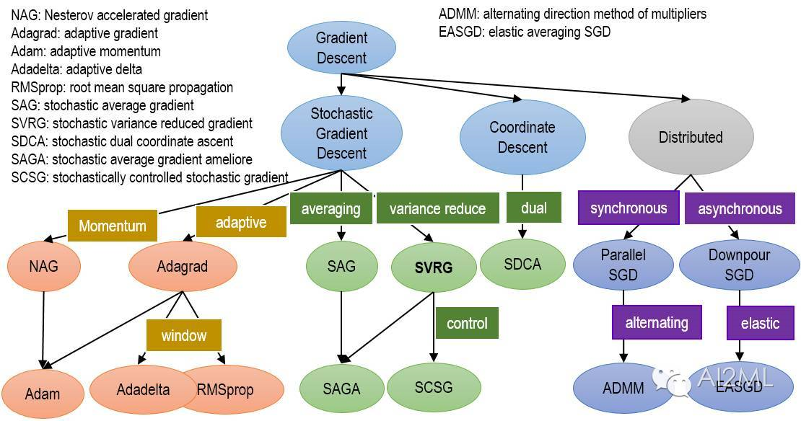
Tensor Network

Slide 18


Tensor Network
2、Variance Reduced Method
$$g_{n}=∇R\left(\tilde{w}\right)−∇f_{ξ}\left(\tilde{w}\right)+∇f_{ξ}(w_{n})$$
e.g. $\tilde{w}=w_{10\left\lfloor \frac{n}{10}\right\rfloor }$
$\tilde{w}, w_{n}→w^{∗}, ∇R\left(\tilde{w}\right)→0;$because$\tilde{w}→w_{n},$ therefore $∇f_{ξ}\left(\tilde{w}\right)→∇f_{ξ}(w_{n})$
so $g→0，M=$var$\left(g\right)→0$
$$E\left[R\left(w_{n}\right)−R(w^{∗})\right]≤ηKM+O\left(ρ^{n}\right) \sim O(ρ^{n})$$
P27

Slide 19
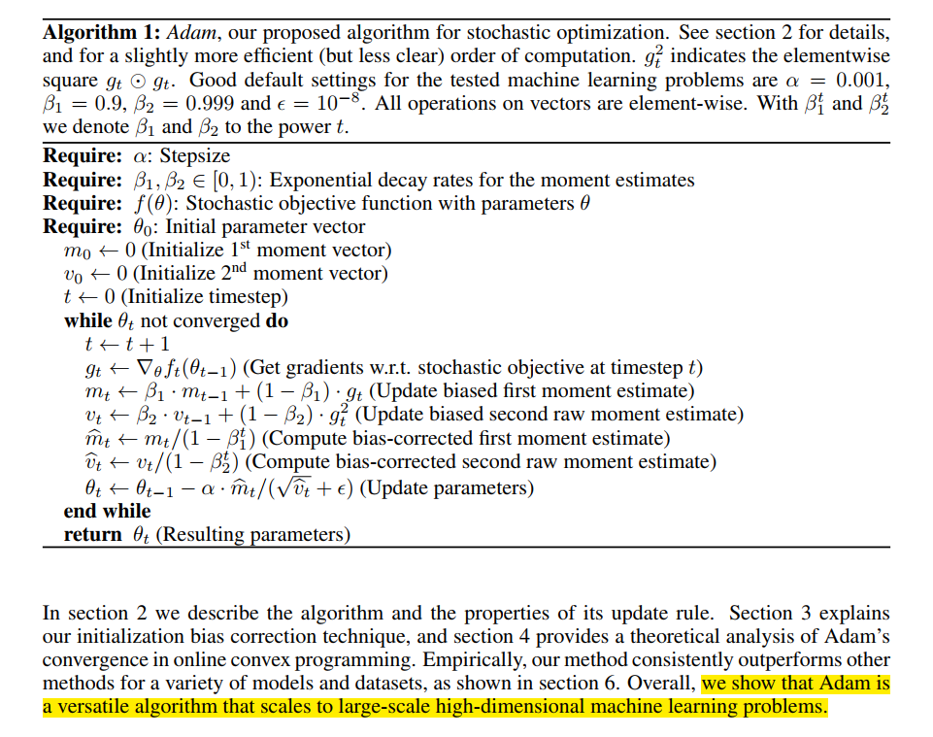
Tensor Network
3、Adam

Slide 20
Tensor Network

Slide 21
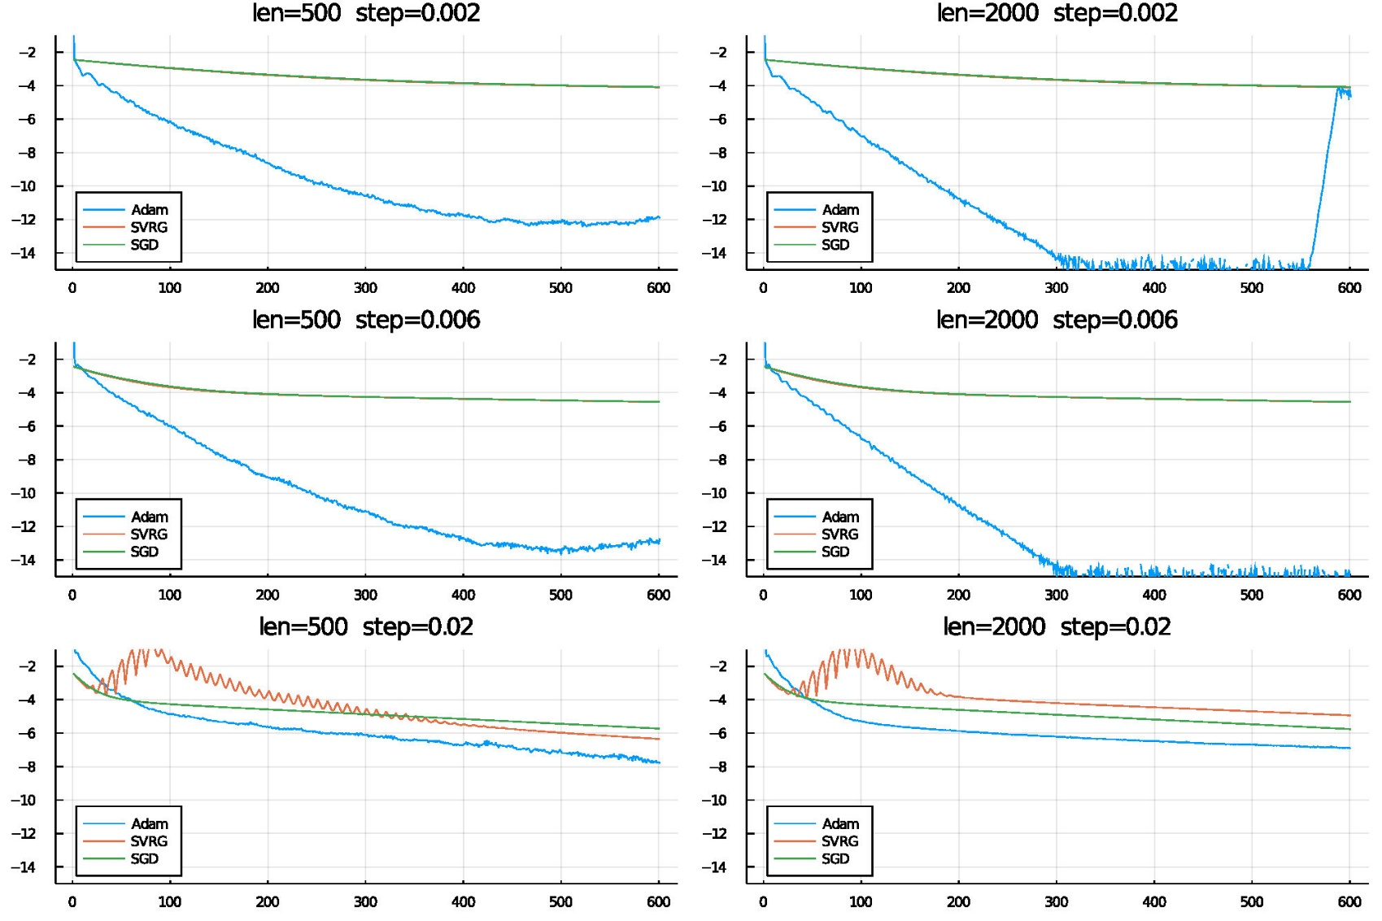
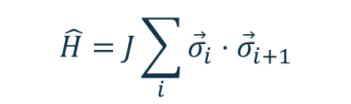
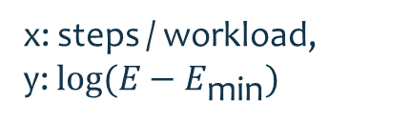

Results
1-dim Heisenberg model:
$$\hat{H}=J\sum_{i}{{\vec{σ}}_{i}⋅{\vec{σ}}_{i+1}}$$
Open Boundary Condition
$$J=−1$$
x: steps / workload,
y: $log(E−E_{\text{min}})$

Slide 22
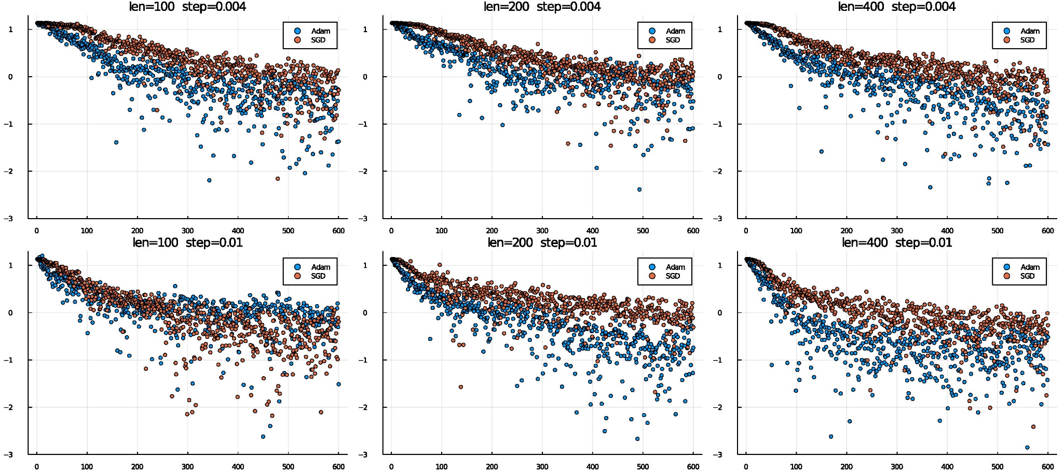

Results
1-dim Heisenberg model:
$$\hat{H}=J\sum_{i}{{\vec{σ}}_{i}⋅{\vec{σ}}_{i+1}}$$
Periodic Boundary Condition
$$J=1$$
x: steps / workload,
y: $log(E−E_{\text{min}})$

Slide 23
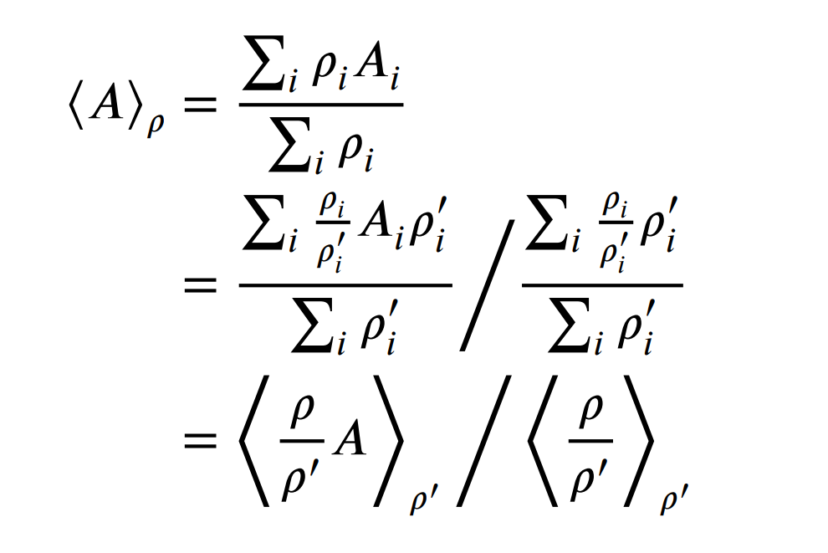

Tensor Network
1-dim Heisenberg model:
reweighting method:
$A$ has a distribution $ρ$, we can calculate the expected value with the data of another distribution $ρ′$.

Slide 24


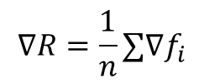
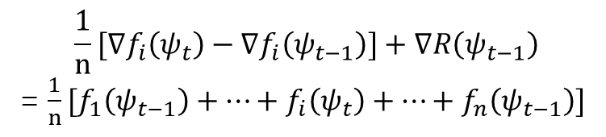

Algorithm
$$∇R=\frac{1}{n}∑∇f_{i}$$
SCSG
$$∇f_{i}\left(ψ\right)−∇f_{i}\left(ψ_{set}\right)+∇R\left(ψ_{set}\right)$$
$$∇f_{i}\left(ψ\right)−∇f_{i}\left(ψ_{old}\right)+∇R\left(ψ_{old}\right)$$
SVRG
SAGA
$$∇f_{i}\left(ψ_{t}\right)−∇f_{i}\left(ψ_{t−1}\right)+∇R\left(ψ_{t−1}\right)$$
$$\frac{1}{n}[∇f_{i}\left(ψ_{t}\right)−∇f_{i}\left(ψ_{t−1}\right)]+∇R\left(ψ_{t−1}\right)$$
= $\frac{1}{n}[f_{1}\left(ψ_{t−1}\right)+…+f_{i}\left(ψ_{t}\right)+…+f_{n}\left(ψ_{t−1}\right)]$
SAG
SGD
SDCA
MISO
Stochastic MISO
24

Slide 25
空白版式

